Slide 1
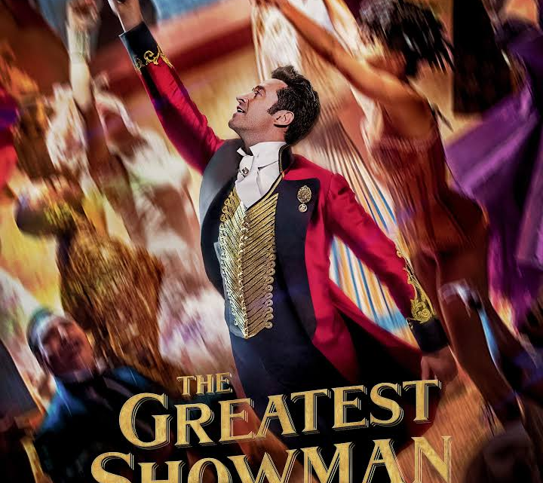
A million dreams for the world we're gonna make…
Notes:
In the movie, The Greatest Showman, the protagonist, Phineas Taylor Barmum, played by Hugh Jackman, talked about his million dreams – his vision of what the world could be.
A young son of a tailor, born of a lowly station in life has large dreams for “a world of incredible wonders”.
He uses whatever means he has, including selling newspapers, joins the railroad, and even resorts to stealing, to raise enough funds for his endeavors.
First mission – to marry his childhood sweetheart, Charity, and then goes to NYC to chase his dreams.
Many of us can identify with Phineas in his aspiration for a better world, and not satisfied with mediocrity, so, let’s go about making a difference in the world!

Slide 2
MY WHY & MY JOURNEY
Liyen Ho

Slide 3
MY LIFE DREAM

Slide 4
After Graduation

Slide 5
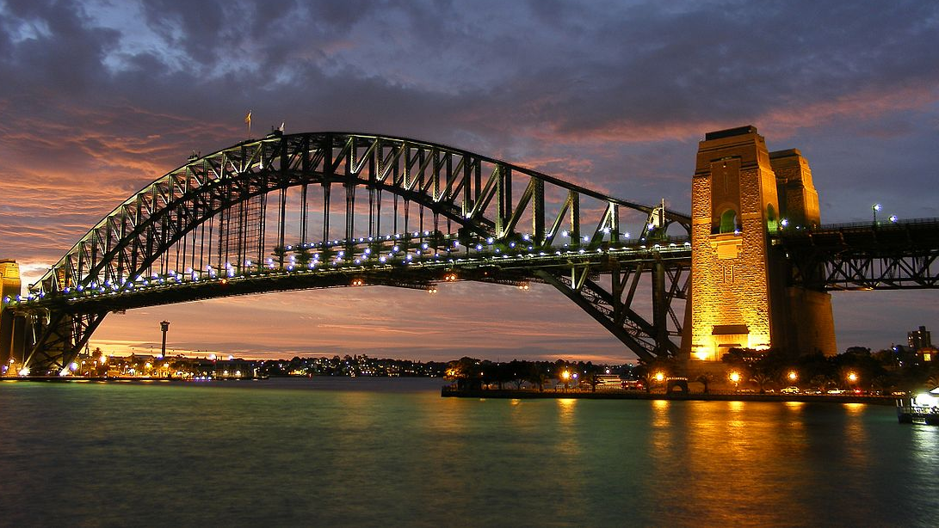
Where my Market America adventure began

Slide 6
Different reactions to change of career

Slide 7
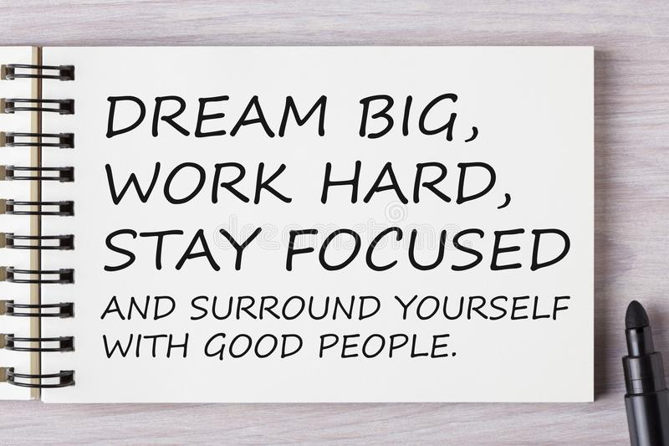

Slide 8
What people see

Slide 9
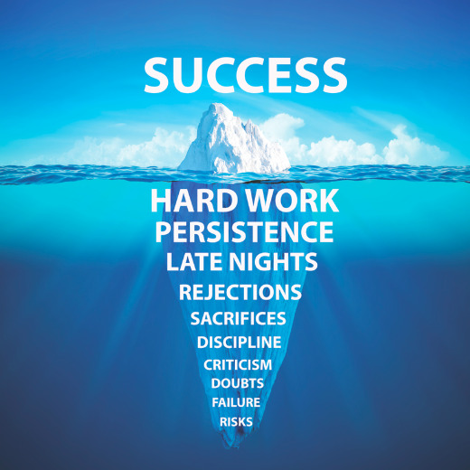

Slide 10
Stay Focused

Slide 11
Be resolute
Don’t worry about what others think or do
It’s your life, your vocation, your calling

Slide 12
Embrace learning
- Devote 8-12 hours per week

Slide 13
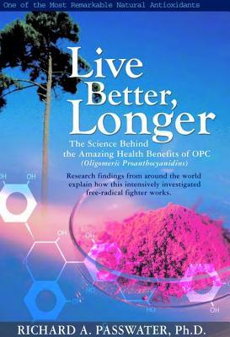
Readers are Leaders

Slide 14
Listen to audios / watch YouTube

Slide 15
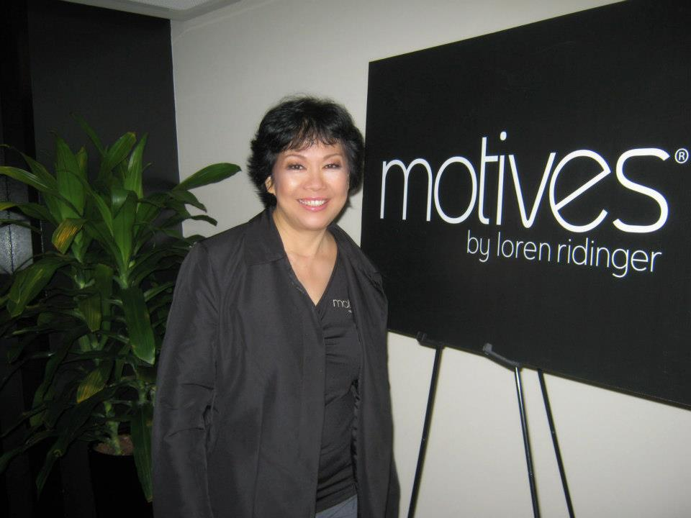
Comfort is the enemy of success

Slide 16
Use All Products From Your Shop.Com
Why do you think you have a fast start kit

Slide 17
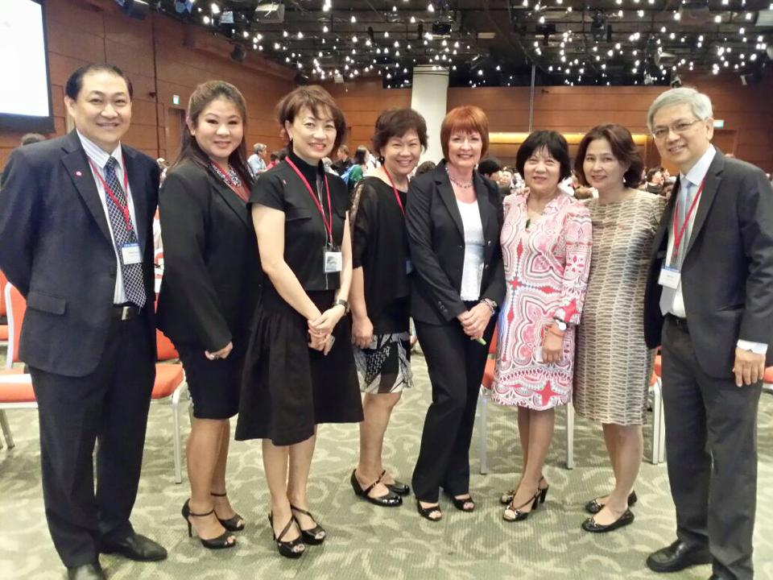
Attend ALL Events – UBPs, Product Events, Local Seminars

Slide 18
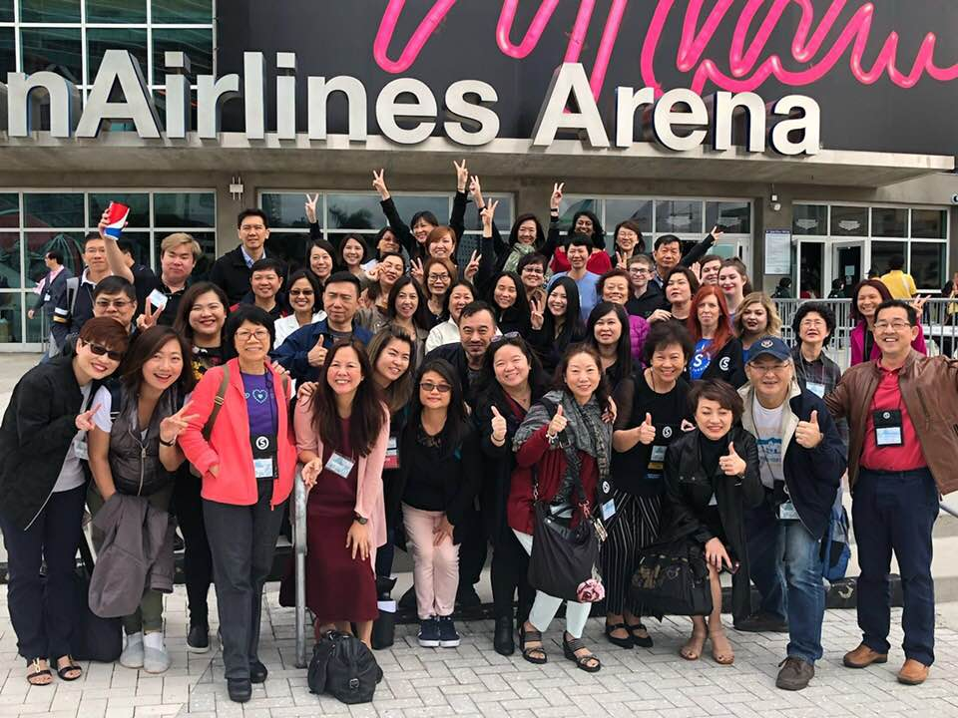
Invest in the MOST important event of your life!

Slide 19
Surround Yourself With Good People

Slide 21
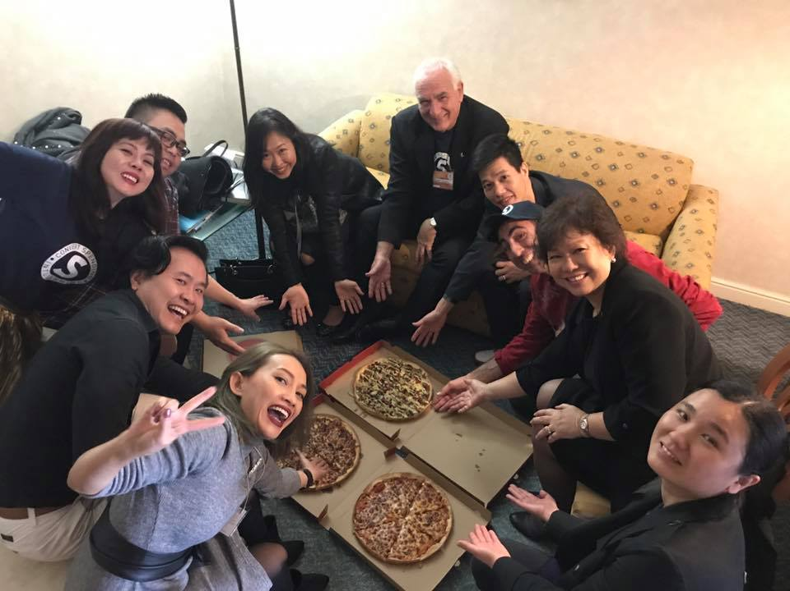
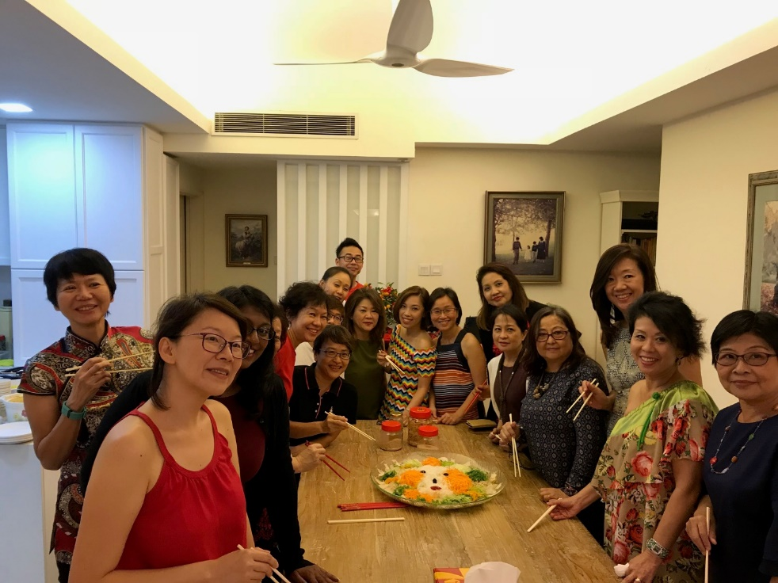
Grateful for the teams…

Slide 22
Amazing Market America family
- Bosses who will build trenches with you
- President who will travel the world for you
- Corporate who will work the 45 year plan
- Market America family that extends the globe

Slide 23
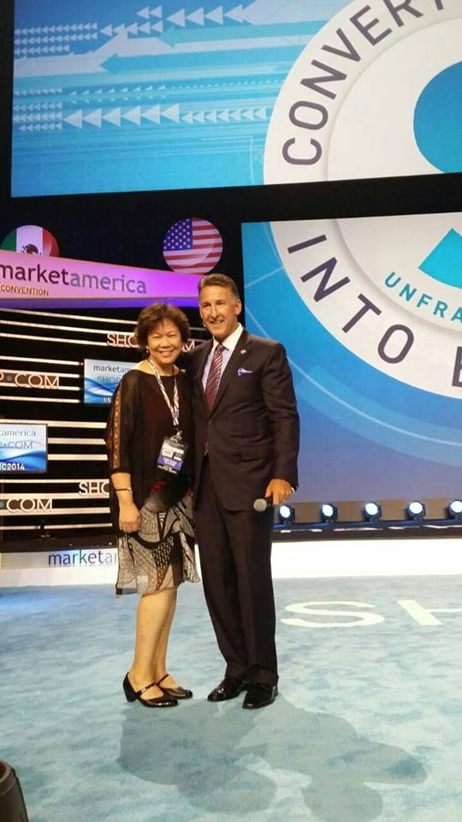
Will Market America work for you too ?
Professional Coordinator 2 years - Australia
Director -5 ½ months - EMP Singapore
Million $ Club Earner -2 ½ years Market Singapore
Jumped 6 Pin levels
from Professional Coordinator to
Field Vice President in 4 years
-

Slide 24
So, what is
my WHY
today?

Slide 25
I always want to be a better me! I take learning seriously…

Slide 26
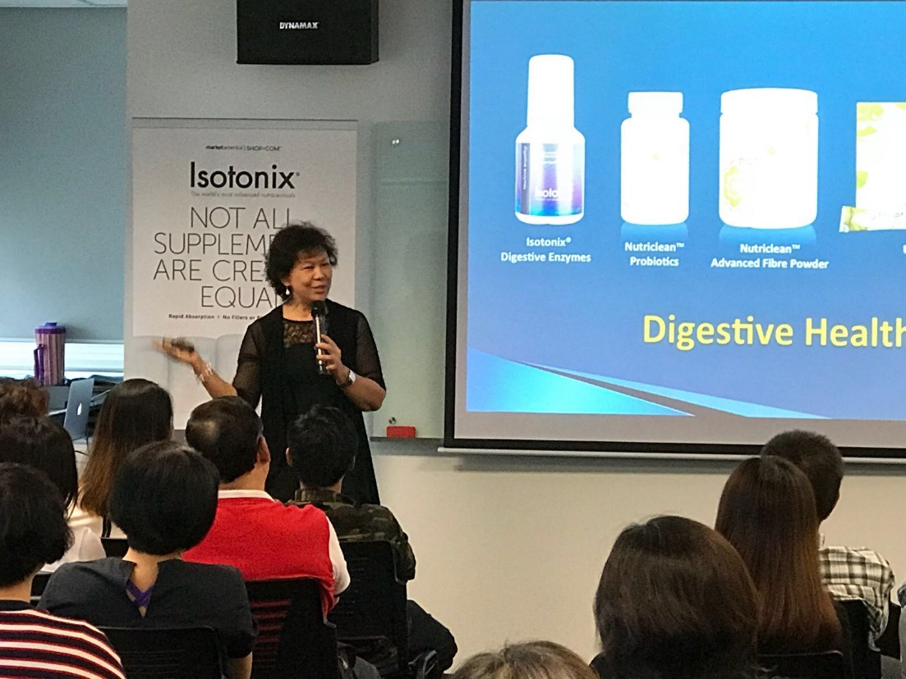
Health and Nutrition

Slide 27
TLS and how it can change lives…

Slide 28
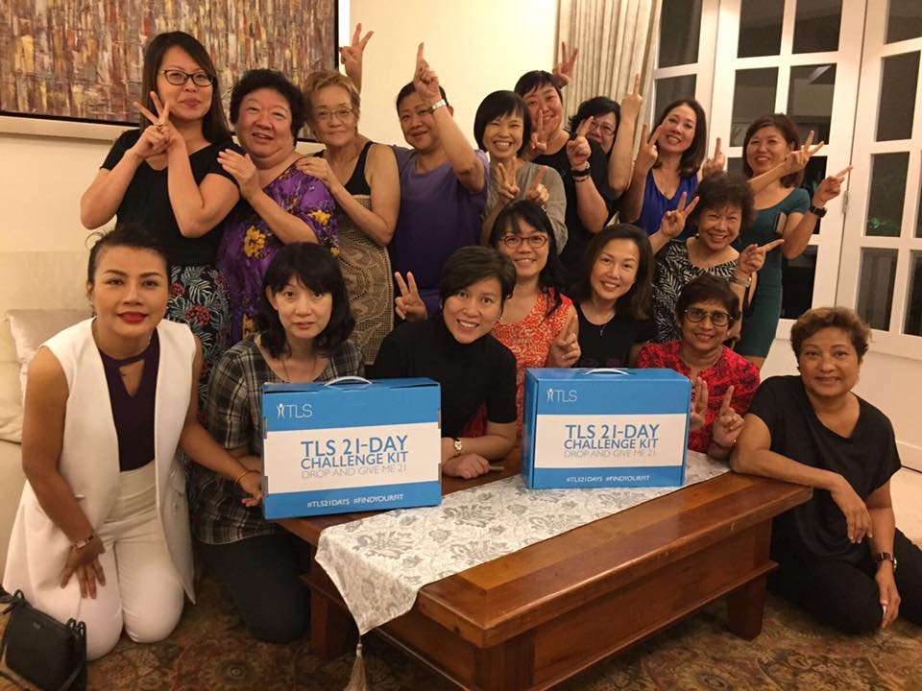
Whether it’s home event

Slide 29
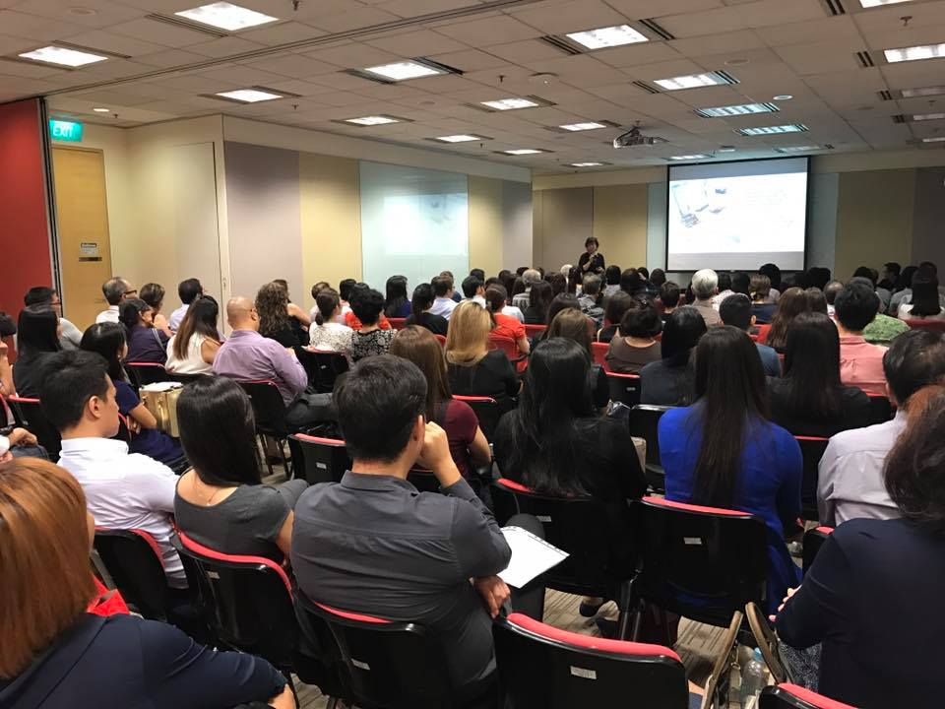
or a big coring…
Or a

Slide 30
…or in GMTSS events

Slide 31
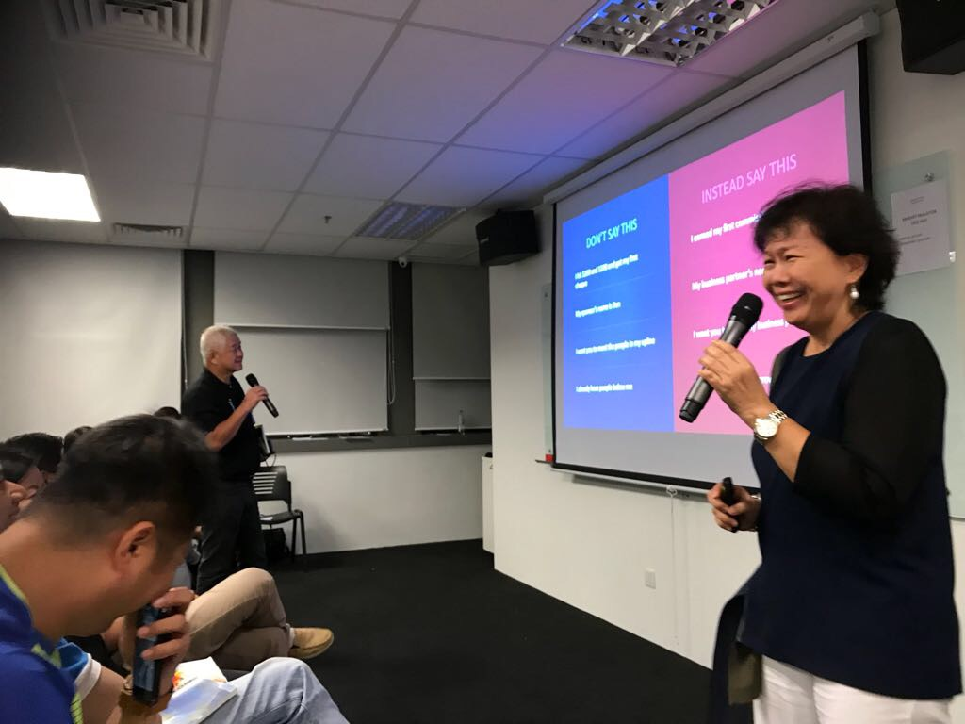
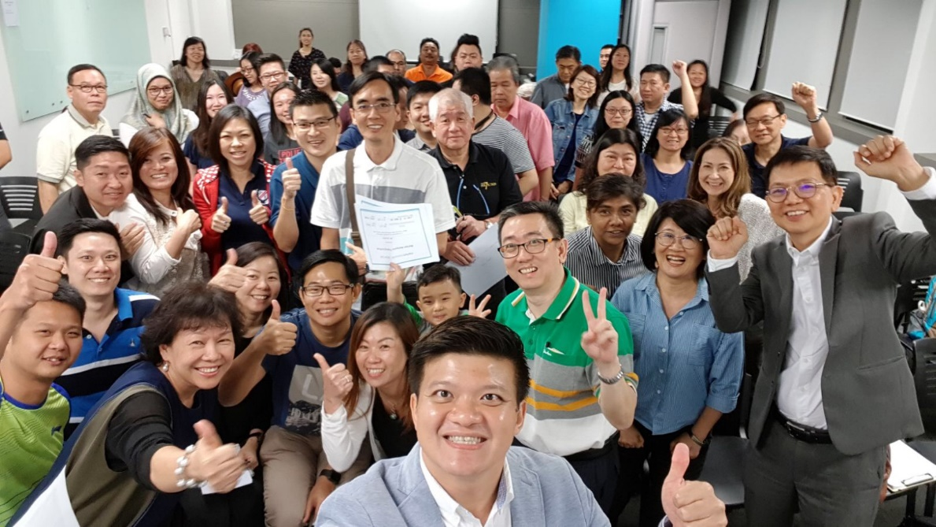
In whichever country…

Slide 32
It’s not about me
It’s about our community
It’s about changing the world, one person at a time

Slide 33
MA is a journey not a trip Discover a new you

Slide 34
Chorus from The Greatest Showman:
'Cause every night I lie in bed The brightest colours fill my head A million dreams are keeping me awake I think of what the world could be A vision of the one I see A million dreams is all it's gonna take A million dreams for the world we're gonna make
Notes:
In the movie, The Greatest Showman, the protagonist, Phineas Taylor Barmum, played by Hugh Jackman, talked about his million dreams – his vision of what the world could be.
A young son of a tailor, born of a lowly station in life has large dreams for “a world of incredible wonders”.
He uses whatever means he has, including selling newspapers, joins the railroad, and even resorts to stealing, to raise enough funds for his endeavors.
First mission – to marry his childhood sweetheart, Charity, and then goes to NYC to chase his dreams.
Many of us can identify with Phineas in his aspiration for a better world, and not satisfied with mediocrity, so, let’s go about making a difference in the world!

